Slide 1

Date / Sprint #
Test Name Here
Dec. 21, 2016

Slide 2
Test Overview
Test Overview

Slide 3
Test Overview
Test Setup
UserTesting.com video/audio recordings
Performed on December 16, 2016
Demographics
10 total subjects
3 female, 18–25
3 female, 40–65+
2 male, 18–25
2 male, 40–65+
Test Overview

Slide 4
Identify the Learning Gap
Objective 1
Can users describe what a service year is, who it is for and when to do it?
How do users differentiate a service year from other experiences?
Can users determine if a service year is right for themselves or their children?
Identify the Learning Gap

Slide 5
Users understood a service year at a high level, but were unable to succinctly describe the steps necessary to complete a service year.
Takeaway #1
Identify the Learning Gap

Slide 6
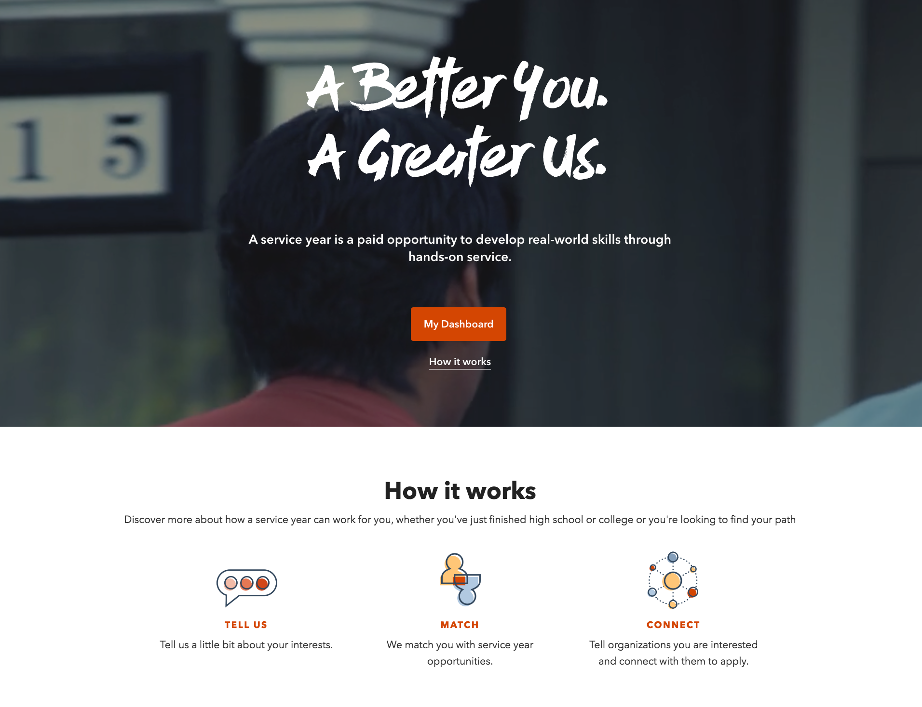
Positive
The homepage hero and How it Works sections helped users understand that:
An individual signs up
An individual tells the system what they’re interested in
An individual receives opportunities that match their interest.
Identify the Learning Gap

Slide 7
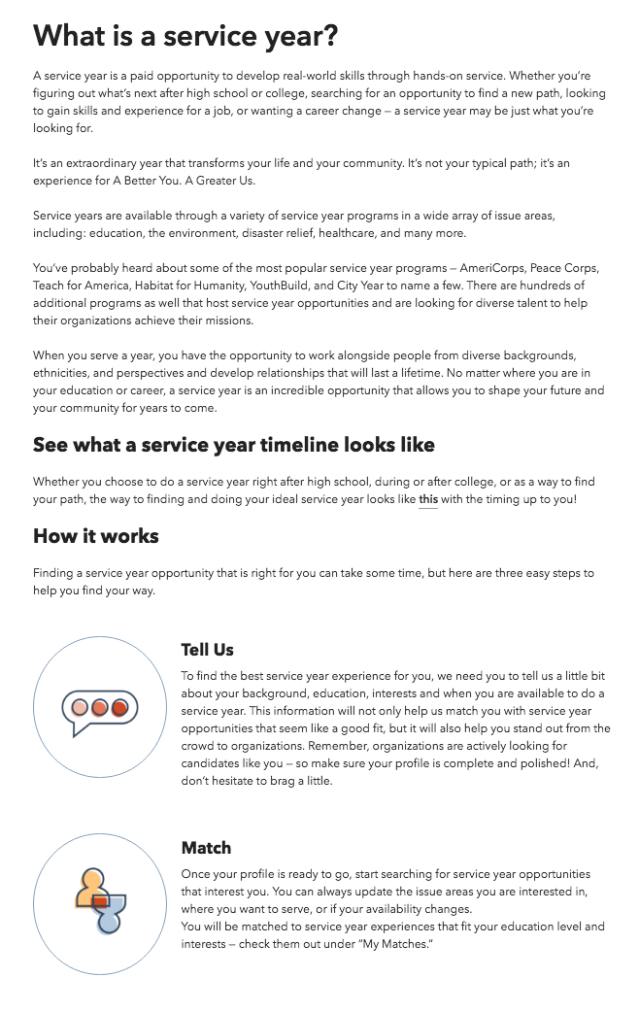
Problem
Users that reached the About page from How it Works skimmed over headlines, largely ignoring paragraph copy.
Identify the Learning Gap

Slide 8
Overall Insights
Users understand that they sign up, get matched, work with org
Subjects didn’t understand how to a SY differs from a typical job or internship
Available benefits = good life experience and get skills, look good on resume
Details and steps not totally clearly
Not sure if they apply through the website
No clear understanding of what happens after start serving
Subjects felt the site had more credibility when they saw trusted partner logos (eg AmeriCorps)
“Find Opportunities” offered a lot of context for what a service is
not clear what “see more” does or what they should expect
Insights

